Slide 1
D ³ : Scaling Up Deepfake Detection by Learning from Discrepancy
Yang Y, Qian Z, Zhu Y, Russakovsky O, Wu Y, CVPR, 2025.
Presented By
Sameera Pisupati

Slide 2
Problem & Motivation
Deepfake generators keep changing → detectors fail on unseen fakes.
Real-world media has JPEG/blur/resizing → detectors break.
Need a detector that generalizes + stays robust.
Goal: universal detector under train-on-many/test-on-many.

Slide 3


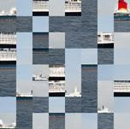



Methodology
s
e
l
f
-
real
Feature
a
Patch-
t
F
t
C
or
shuffle
e
Extractor
n
t
fake
i
o
n
Frozen
Trainable
Dual-Path Discrepancy Feature Extraction.
  e_{o} = CLIP∗(AUG(x_{o}))
  e_{s} = CLIP∗(PS(AUG(x_{o})))
Discrepancy Fusion via Self-Attention: e = [e_{o},e_{s}].
Training Objective

Slide 4
Experimental Setup
Datasets: UFD dataset + GenImage dataset merged for scaled-up setup.
Baselines compared: CNNDet / PatchFor / LNP / DIRE / UFD
Train/Test split: In-domain (seen generators) vs Out-of-domain (unseen generators)
Metrics: Mean Accuracy, AP (Average Precision)

Slide 5
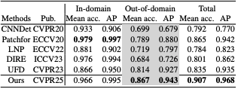
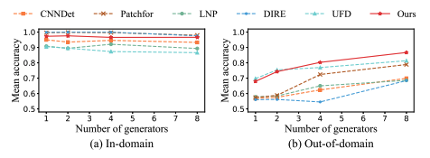
Main Results: SOTA + Scaling with More Generators
Table: Benchmark Comparison Across Detectors

Slide 6
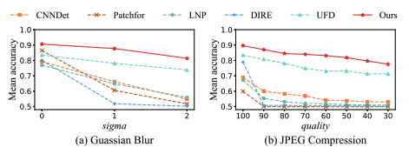

Robustness + Ablation
Table: Model-Component Ablation

Slide 7

Disruption Tests
Table: Augmentation Comparison
Patch shuffling In-domain: Mean acc 0.972, AP 0.995.
Patch shuffling best OOD Mean acc: 0.87.
Patch shuffling best Total Mean acc: 0.913.
Patch shuffling gives the strongest discrepancy → best performance among disruptions

Slide 8
Conclusion
D3 learns deepfake cues from discrepancy.
Patch shuffling is the key design that boosts generalization.
Improves out-of-domain detection while keeping strong in-domain performance.
More robust under real-world distortions.
Scales better as training includes more generator diversity.

